Slide 1

Breast Cancer Detection Using Machine Learning
Batch No: B-06 Project Guide:
K.SUMIYA (164G1A05A6) Mr. G. Hemanth Kumar Yadav, M.Tech(Ph.D)
S.NAHIDA ANJUM (164G1A0562) Assistant Professor`
G.TEJASWINI (164G1A05B2)
C.S.THAYYABA SULTANA (164G1A05B3)
Srinivasa Ramanujan Institute of Technology
Department of Computer Science & Engineering

Slide 2
Contents
Introduction
Abstract
Algorithms
Output
Conclusion
References

Slide 3
Introduction
After skin cancer, breast cancer is the most common cancer diagnosed in women all over the world. The early diagnosis of a cancer is very important to determine the course of medical treatment required by the patient
The data science and machine learning algorithms are used for classification of cancerous cells into benign or malignant
Using too many features can sometimes make predictions worse

Slide 4
Existing System:
Existing Systems aims to present comparison of the largely popular machine learning algorithms and techniques to detect breast cancer
Most of the models were build with utmost 30 features and some problems arise due to the large number
Proposed System:
Feature selection can make use of less number of data features to give best possible accuracy
The main goal of this project is to build a model to obtain best possible accuracy with minimal set of features to classify whether the cancerous cells are benign or malignant

Slide 5
Abstract
Breast cancer is the second most diagnosed cancer accounting for 25% of all cancer cases Early detection plays vital role to provide medication within time
For all of the features present in the dataset might not be useful and too many features might even make the predictions worse
Our projects aims to build a model using a subset of features obtained through feature selection and gives the best possible accuracy as a result

Slide 6
Feature Selection
It is the process of selecting a subset of relevant features (variables, predictors) for use in model construction.
Types:
Filter methods
Wrapper Methods
Embedded methods
In our project we have used Sequential Forward Selection and Sequential Backward Elimination techniques which comes under wrapper methods

Slide 7
.
1.Sequential Forward Selection
SFS Starting from the empty set, sequentially
Add the feature 𝑥 + that maximizes 𝐽(𝑌𝑘 + 𝑥 +) when combined with the features 𝑌𝑘 that have already been selected .
2.Sequential Backward Elimination
Starting from the full set, sequentially remove the feature 𝑥 that least reduces the value of the objective function 𝐽(𝑌 − 𝑥 −)
Removing a feature may actually increase the objective function 𝐽(𝑌𝑘 − 𝑥 −) > 𝐽(𝑌𝑘);

Slide 8
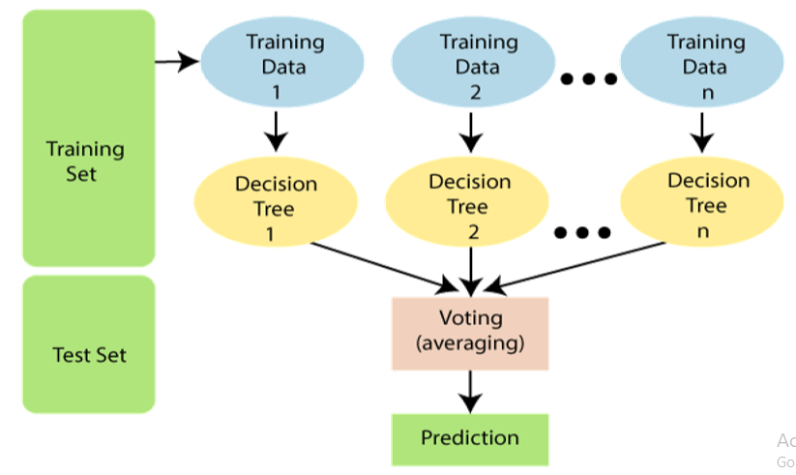
Random forest(Classifier)
Supervised learning technique that can be used for both classification and regression problems
It contains a number of decision trees on various subsets of the given dataset and takes the average(voting based) to improve the predictive accuracy of the dataset

Slide 9
Metrics:
1. Accuracy : Accuracy is one metric for evaluating classification models. It is the Number of correct predictions.
Accuracy = TP+TN/TP+FP+FN+TN.
2. Confusion Matrix: A confusion matrix is a table that is often used to describe the performance of a classification model on a set of test data for which the true values are known.
3. Precision : Precision is the ratio of correctly predicted positive observations to the total predicted positive observations.
Precision = TP/TP+FP.
4. Recall : Recall is the ratio of correctly predicted positive observations to the all observations in actual class
Recall = TP/TP+FN.
Where TP=true positive, TN=true negative, FP=false positive , FN=false negetive.

Slide 10
Sequential forward selection(SFS)
Implementation Code:
clf=RandomForestClassifier(n_estimators=100,n_jobs=-1)
sfs1=sfs(clf,k_features=9,forward=True,scoring='accuracy‘,cv= 5,verbose=2)
sfs1=sfs1.fit(X_train,Y_train)
feat_cols=list(sfs1.x_feature_idx_)
Print(feat_cols)

Slide 11
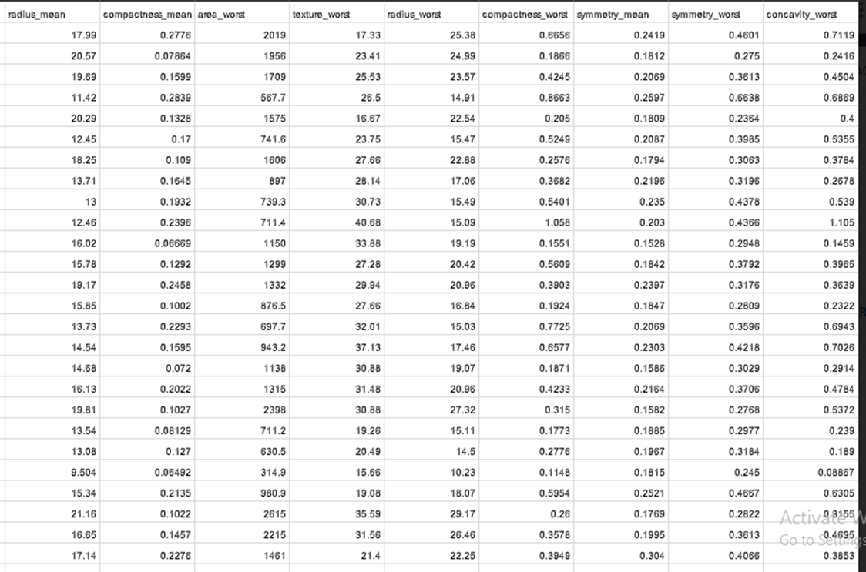
Features obtained by applying SFS:

Slide 12
Sequential Backward Elimination (SBE):
Implementation Code:
clf=RandomForestClassifier(n_estimators=100,n_jobs=-1)
sfs1=sfs(clf,k_features=9,forward=False,floating=False,scoring='accuracy',cv= 5,verbosve=2)
sfs1=sfs1.fit(X_train,Y_train)
feat_cols=list(sfs1.x_feature_idx_)
Print(feat_cols)

Slide 13
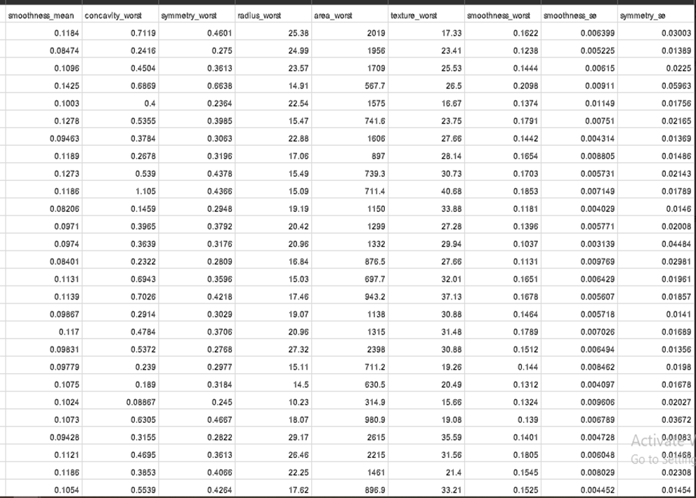
Features obtained by applying SBE:

Slide 14
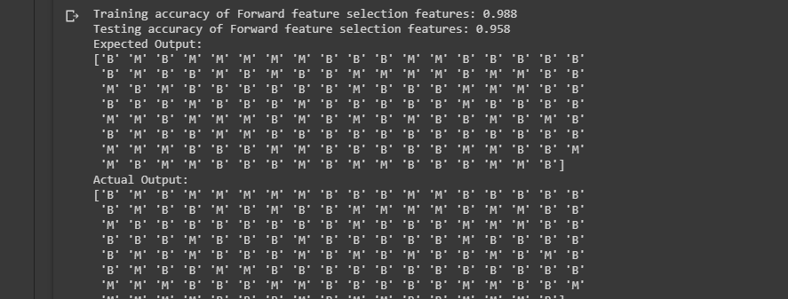
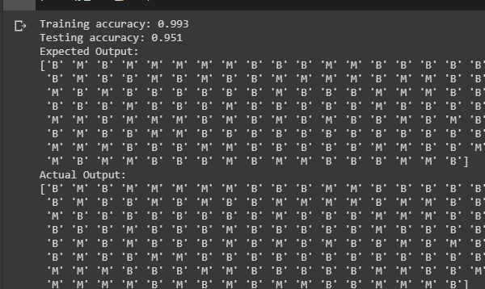
Predictions code: prediction=clf.predict(X_test).
Prediction of SFS features:
Prediction of SBE features:

Slide 15
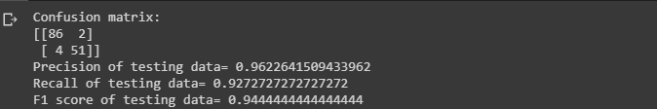
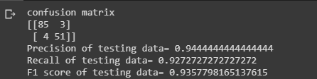
Metrics:
SFS results:
BES results:

Slide 16
Conclusion:
In our project we have applied two feature selection techniques(SFS and SBE)and a single classifier(Random Forest)
The accuracy for Forward Selection is 95.8 which is effective than Backward Elimination
This project classifies cancerous cells to be benign or malignant with best possible accuracy using 9 selected features among 30 features

Slide 17
References:
JOURNALS
[1] Sreyam Dasgupta, Ronit Chaudhuri, Swarnalatha Purushotham “Feature Selection for Breast Cancer Detection using Machine Learning Algorithms”, International Journal of Innovative Technology and Exploring Engineering (IJITEE) ISSN: 2278-3075, Volume-8 Issue-9, July 2019
[2] HabibDhahri Eslam Al Maghayreh, Awais Mahmood,Wail Elkilani & Mohammed Faisal Nagi “Automated Breast Cancer Diagnosis Based on Machine Learning Algorithms” Journal of Health Care Industry Volume 2019,Article ID 4253641,11 pages
CONFERENCE PAPERS
[3] Bin Dai ; Rung-Ching ; Chen Shun-Zhi Zhu ; Wei-Wei Zhang “Using Random Forest Algorithm for Breast Cancer Diagnosis”, 2018 IEEE International Symposium on Computer, Consumer and Control (IS3C)

Slide 18
Any Queries??

Slide 19
Thank You☺

